Slide 1
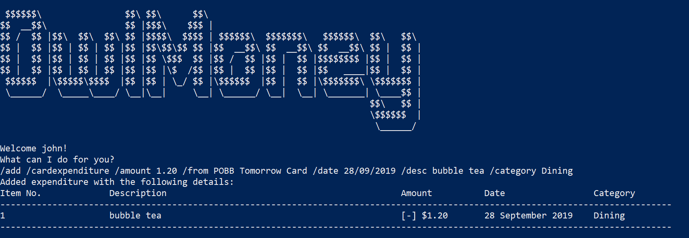
Successful adding of card expenditure
Command entered

Slide 2
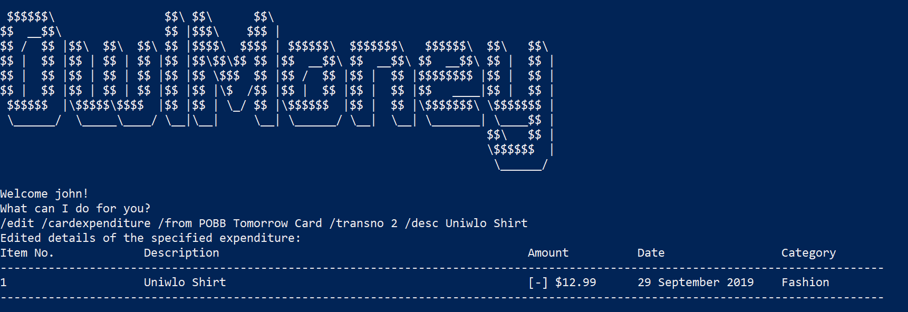
Successful adding of card expenditure
Command entered

Slide 3
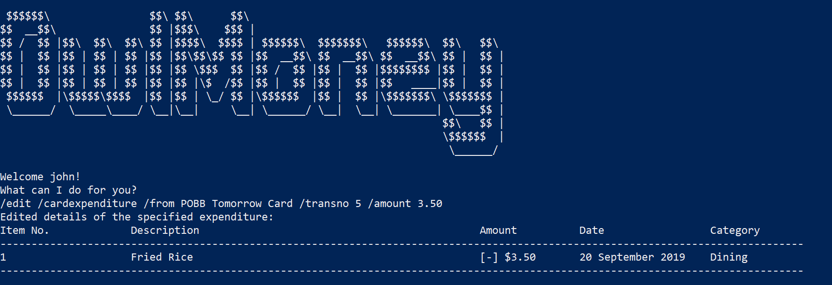
Successful adding of card expenditure
Command entered

Slide 4
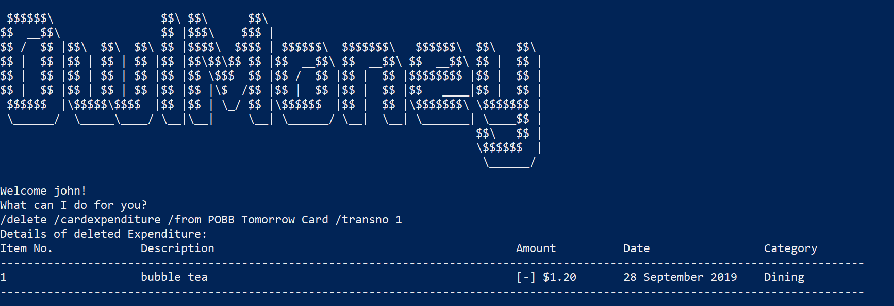
Successful adding of card expenditure
Command entered

Slide 5
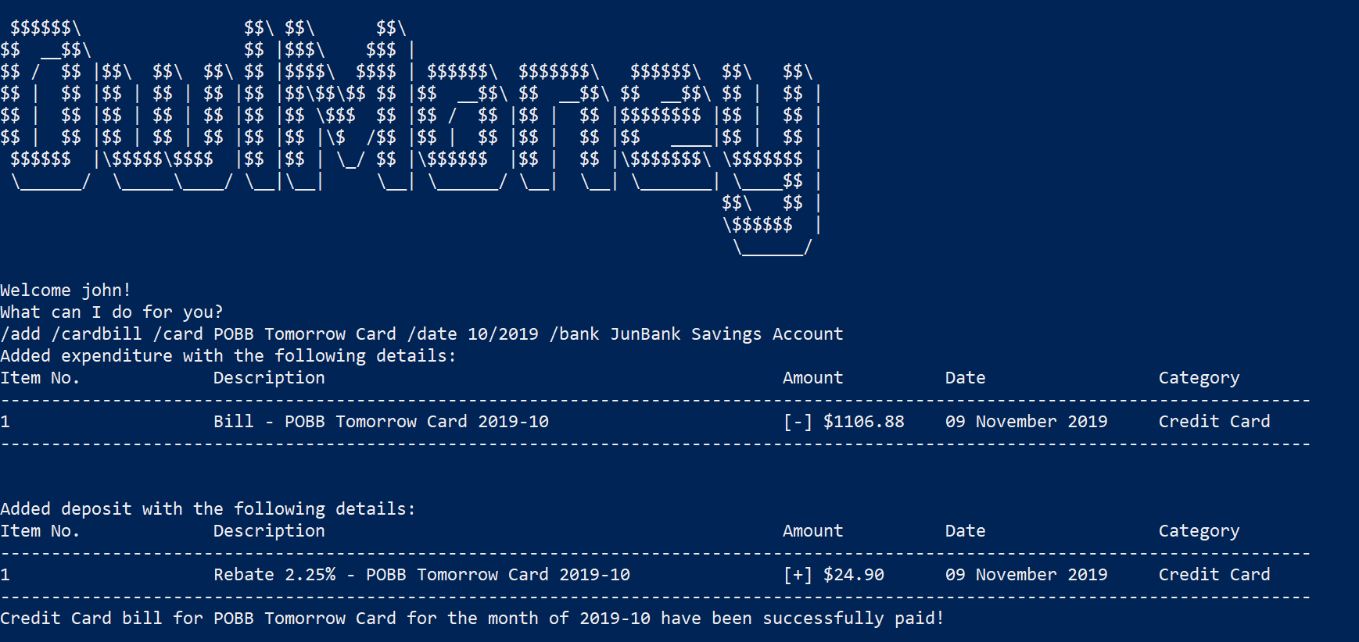
Successful adding of card expenditure
Command entered

